Slide 1
Pixel 3 GMS App Investigations
Part 4: Google Photos
Notes:
https://digitalcorpora.s3.amazonaws.com/corpora/mobile/android_10/Non-Cellebrite%20Extraction/Pixel%203.zip

Slide 2
What is Google Photos ?

Slide 3
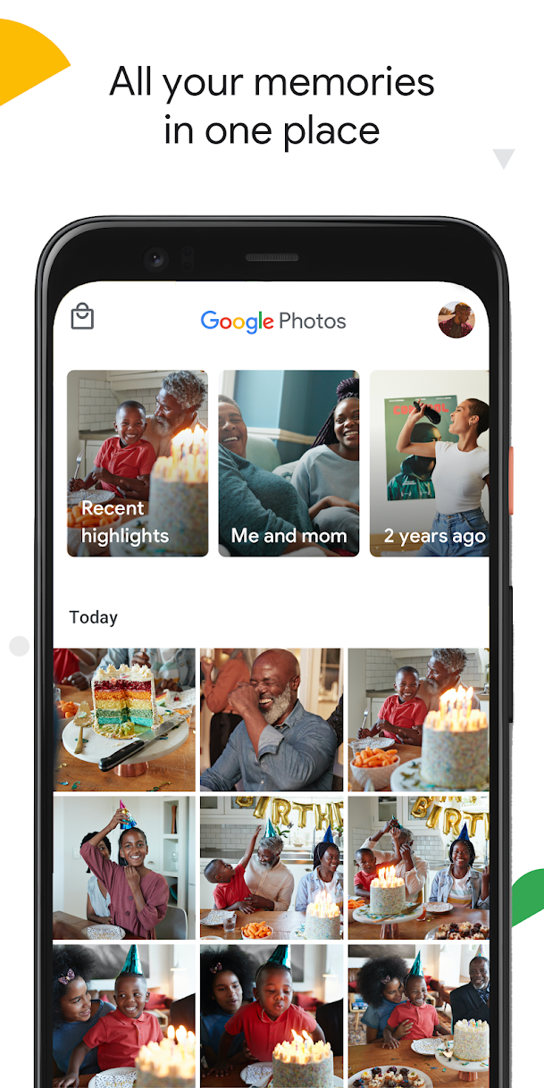
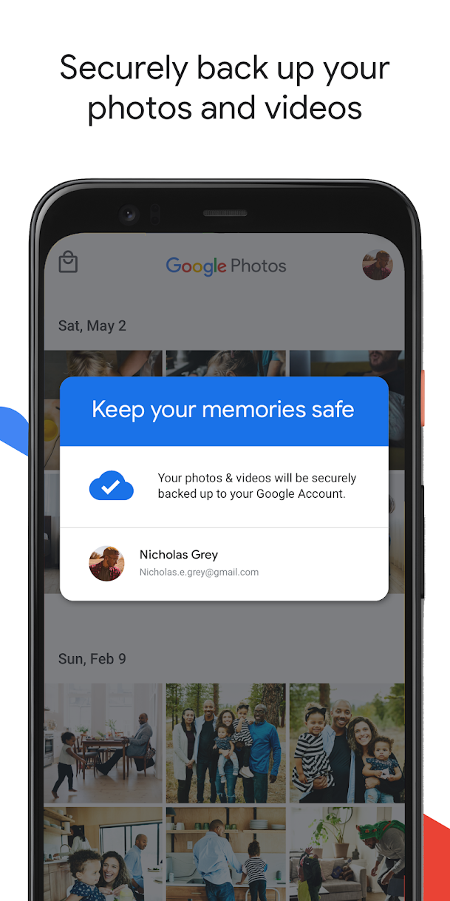
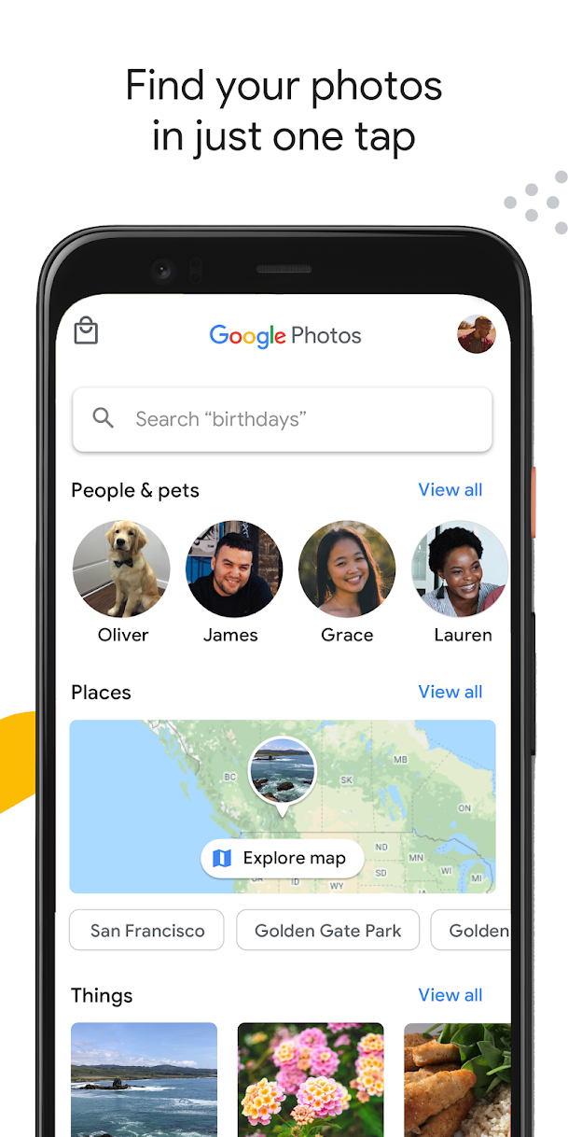
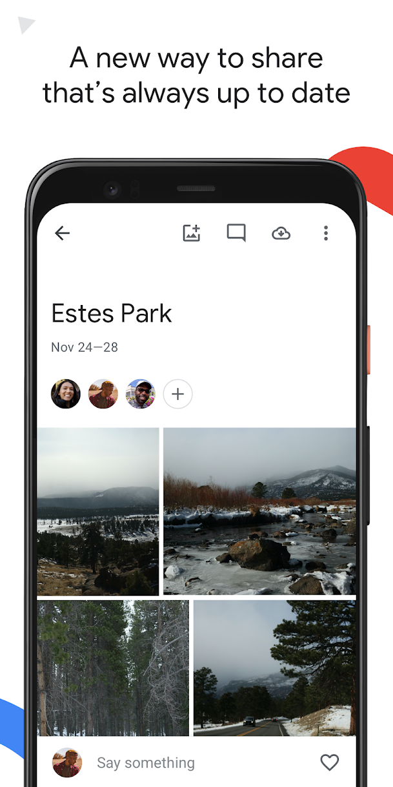
A cloud-based photo and video storage and sharing service

Slide 4
Google Photos features
Cloud storage
Automatic backup and sync
Search and organization
Advanced editing suite
Shared albums
Memories and creation
Face and object recognition
Cross-platform availability

Slide 5
How to know if backup is enabled?
Any photos that you take from a device with backup enabled will be saved to your Google Account.
If you edit and save a photo on your phone, the photo will look the same on Google Photos
Shared Preferences is the folder where such information gets stored.
Allow activities and applications to keep preferences.
Store user-specified configuration details, such as user-specific settings, keeping the user logged into the application

Slide 6
Why it's important to look for back up?
Backup is crucial in an investigation because:
Suspect may have deleted data related to the case but took back up before deleting
If the system crashes, data can be recovered quickly from backup
Backup is done to save something important
Timestamps of the backup can be useful

Slide 7
Sample questions
What photos are saved? location and timestamps
What location has the most photos?
Did a suspect receive the photos from someone, or were they clicked using the phone?
Can we deduce the suspect's relation to people in the photos/videos?
Are there any deleted photos?

Slide 8
Google Photo Directory

Slide 9
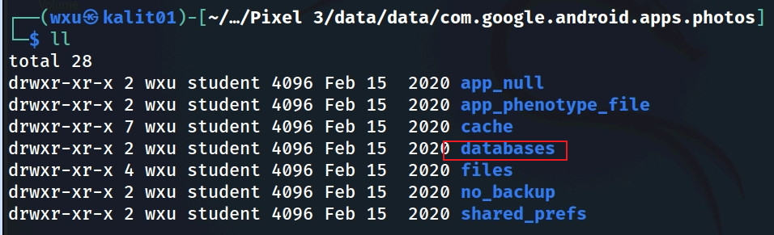
Show Google Photos package structure
Notes:
Cmd: tree 'Pixel 3/data/data/com.google.android.apps.photos' -L 1

Slide 10
Google Photo Databases

Slide 11
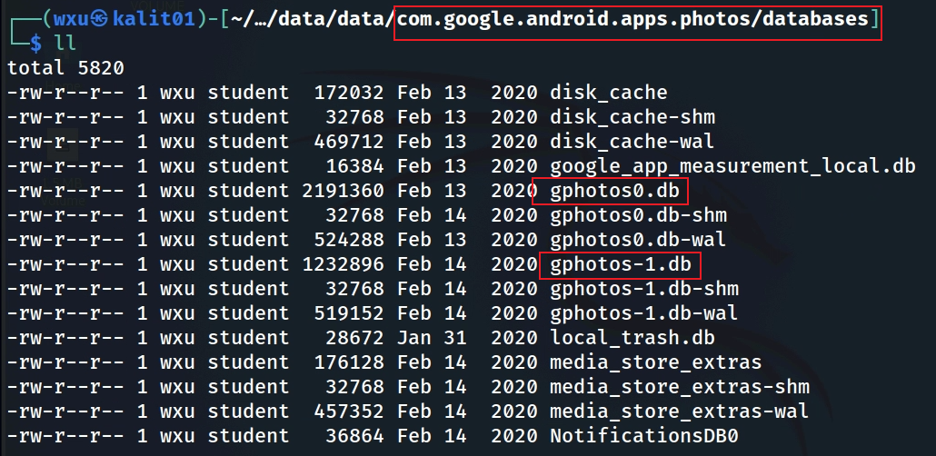
Valuable databases
photosx.db: Image storage
disk_cache: which are temporary storage for app performance
local_trash.db: which tracks deleted item
NotificationsDB0: which logs app notifications
Notes:
Cmd: tree 'Pixel 3/data/data/com.google.android.apps.photos/databases'

Slide 12
gphotos_1.db

Slide 13
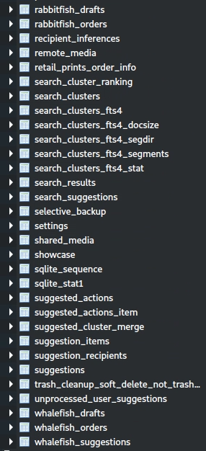
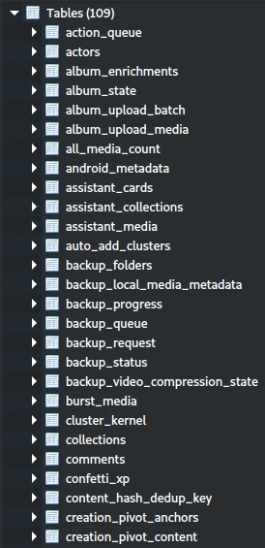
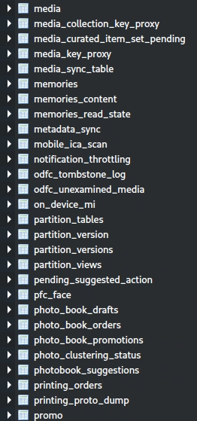
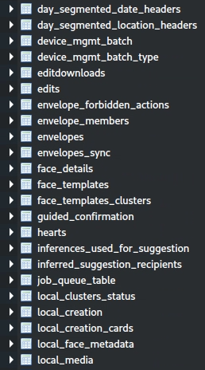
tables in gphotos-1.db
Notes:
Cmd: sqlitebrowser 'Pixel 3/data/data/com.google.android.apps.photos/databases/gphotos-1.db'

Slide 14
Grouping of Tables Based on Google Photos Functions
Media Storage and Metadata Evidence: Stores core data about photos, videos, and their metadata, which are critical for accessing media files and their associated details.
media, local_media, remote_media, all_media_count
User Activity and Interaction Evidence: track user interactions with the app, such as sharing, favoriting, hiding, or editing media, revealing behavioral patterns.
action_queue, shared_media, editdownloads, edits, envelope_forbidden_actions

Slide 15
media tables
It is the core of the Google Photos database
Storing detailed information about photos and videos, such as file paths, IDs, timestamps (e.g., creation, modification, upload dates), and metadata (e.g., size, resolution).
Include references to cloud-synced media.
Forensic Insights:
Timestamps can establish a timeline of when media was captured or uploaded.
Metadata might include geolocation (where a photo was taken), which can place a suspect at a specific location.
Links to deleted media might still be recoverable if not overwritten.
Example Use: An investigator could use this table to find a photo taken at a crime scene, including its geolocation and timestamp.

Slide 16
local_media tables
It stores information about media files stored locally on the device, as opposed to cloud-synced media.
Include file paths, sizes, and statuses (e.g., synced, pending upload).
Forensic Insights:
Reveals media that hasn’t been uploaded to the cloud, which might be intentionally kept offline.
Can show recently accessed or modified media, even if deleted from the app’s visible gallery.
File paths can lead investigators to the actual media files on the device.
Example Use: Finding a locally stored photo that the user didn’t upload, which might contain incriminating evidence.

Slide 17
backup_local_media_metadata tables
The table contains metadata for media queued for backup or already backed up
including timestamps, file sizes, and possibly EXIF data (e.g., camera details, geolocation).
Forensic Insights:
Timestamps can show when a photo was marked for backup, indicating user activity.
EXIF data can reveal where and how a photo was taken (e.g., device model, GPS coordinates).
Can help reconstruct a timeline of media management activities.
Example Use: Corroborating a suspect’s location by matching geolocation data with a known crime scene.

Slide 18
media tables

Slide 19
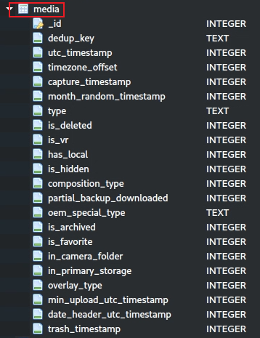
media table schema
utc_timestamp: Stores the UTC timestamp of when the media was created, uploaded, or modified.
capture_timestamp: Records the timestamp when the media was originally captured (e.g., photo taken).
trash_timestamp: Indicates the timestamp when the media was moved to the trash.
is_deleted: Flags whether the media has been marked as deleted (0 or 1).
has_local: Shows if the media is stored locally on the device (0 or 1).id: Provides a unique identifier for each media item in the database.
dedup_key: Contains a hash key to identify duplicate media files.
date_header_utc_timestamp: Stores the UTC timestamp for organizing media in the app’s date-based UI.
is_favorite: Indicates if the user marked the media as a favorite (0 or 1).
is_hidden: Flags whether the media is hidden from the main gallery view (0 or 1).

Slide 20
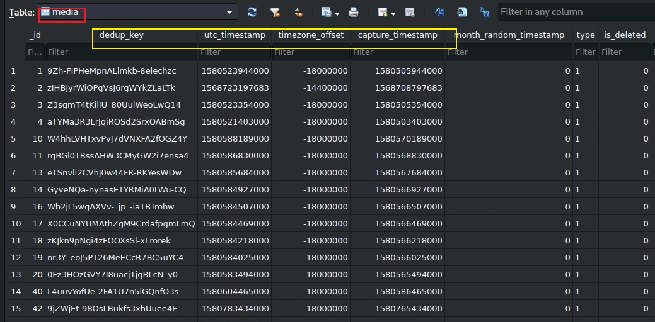

Slide 21
local_media tables
contains photos

Slide 22
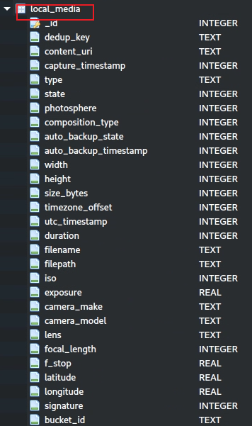
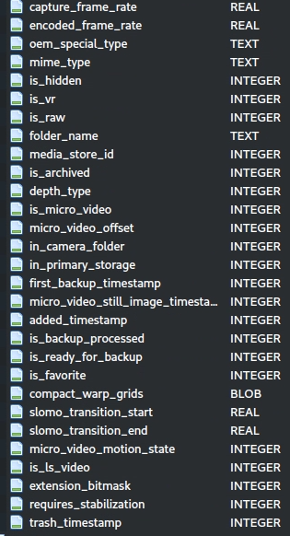
local_media table schema
Direct Access (filepath, content_uri): These columns are top-ranked because they provide direct access to the media file, which is critical for retrieving evidence.
Timestamps (capture_timestamp, utc_timestamp): Essential for establishing a timeline of when the media was created or modified.
Identifiers (dedup_key, id): Enable matching and cross-referencing media across the database, aiding in comprehensive analysis.
Behavioral Flags (is_favorite, is_hidden): Highlight media the user prioritized or hid, often pointing to significant content.
Metadata (filename, longitude, latitude): Provide context and location.

Slide 23
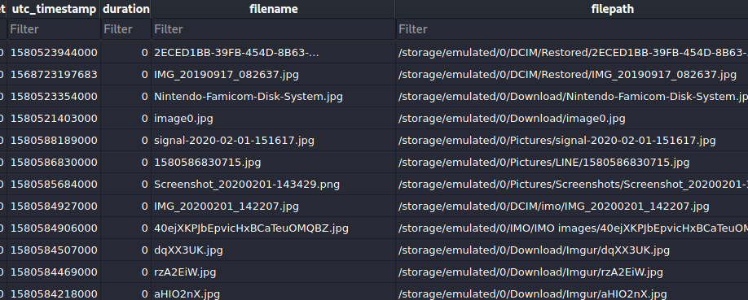
one sample picture in local_media table

Slide 24

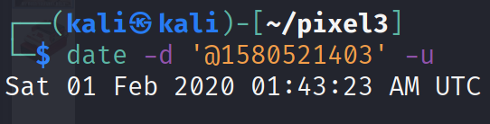
Solution (download images)
Image0.jpg
Date when image was clicked

Slide 25
Shared preference

Slide 26
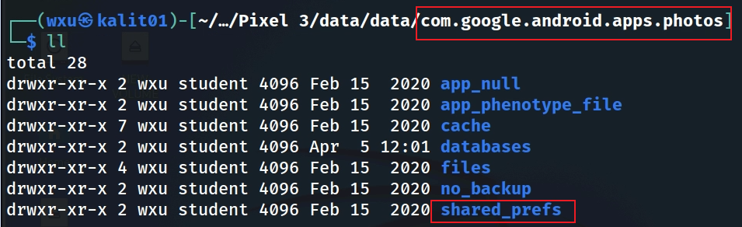
shared_prefs folder

Slide 27
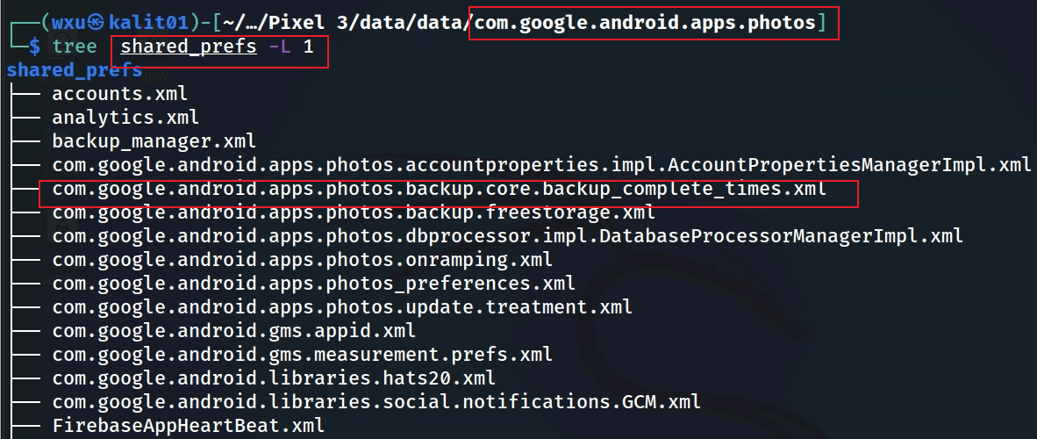
backup information in shared_prefs
Notes:
Cmd: tree 'Pixel 3/data/data/com.google.android.apps.photos/shared_prefs' -L 1

Slide 28
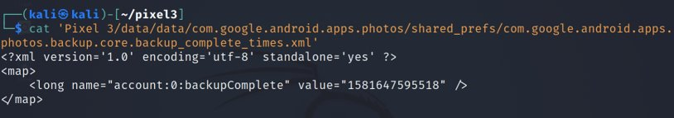
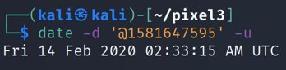
Open the file
This is the time when the account back up was done
Solution: timestamp
Notes:
Cmd: cat 'Pixel 3/data/data/com.google.android.apps.photos/shared_prefs/com.google.android.apps.photos.backup.core.backup_complete_times.xml'
Date cmd: date –d '@1581647595' -u

Slide 29
To summarize
Understand the application
Locate the application package
Look at the application directories
Go to the databases directory
Open gphotos-1.db
Explore local_media table
Go to the shared prefs folder
Find the the file that contains back up information

